Slide 1
DIGITAL PORTFOLIO
Name:
Keerthana k
Register Number:
2422k1359
Nm id :
FB172B36567DAFB960947E603310DEE7
Department:
Computer science
College:
Kathir college of arts and science

Slide 2


The Digital Challenge: Why Businesses Need Smart Tech
Notes:
1

Slide 3
AGENDA
Problem statement
project overview
End user
Tools and technology
portfolio of design and layout
Feature and functionality
Result and screenshot
Conclusion
GitHub link

Slide 4

Problem Statement: The Digital Divide
In today's rapidly evolving digital landscape, businesses face immense pressure to innovate and adapt. Many struggle with outdated systems, inefficient processes, and a lack of integrated solutions, leading to lost opportunities, reduced productivity, and a disconnect with modern customer expectations. This digital divide hinders growth and competitive advantage.
Notes:
2

Slide 5

Project Overview: Bridging the Gap
This project aims to develop a comprehensive, scalable digital solution designed to streamline operations, enhance user experience, and drive measurable growth for modern businesses. We focus on creating intuitive, powerful tools that integrate seamlessly into existing workflows.
Our approach emphasizes user-centric design and robust technological frameworks to ensure a future-proof solution.
Notes:
3

Slide 6




End Users: Empowering Diverse Stakeholders
Our solution caters to a broad spectrum of end-users, each with unique needs and objectives:
Executives
Customer Service Teams
Gain high-level insights, track KPIs, and make data-driven strategic decisions.
Access comprehensive customer data for personalized and efficient support.
Sales & Marketing
Operations Staff
Automate campaigns, manage leads, and analyze market trends for targeted outreach.
Streamline workflows, manage inventory, and optimize resource allocation.
Notes:
4

Slide 7
Tools & Technology: Our Foundation
Our robust solution is built upon a modern, reliable, and scalable technology stack:
1
2
Front-End
Back-End
React.js, HTML5, CSS3, JavaScript. Ensuring a dynamic and responsive user interface.
Node.js, Python/Django, RESTful APIs. For powerful server-side logic and data handling.
3
4
Database
Cloud Infrastructure
PostgreSQL, MongoDB. Secure and efficient data storage solutions.
AWS, Docker, Kubernetes. For scalable deployment and reliable performance.
Notes:
5

Slide 8
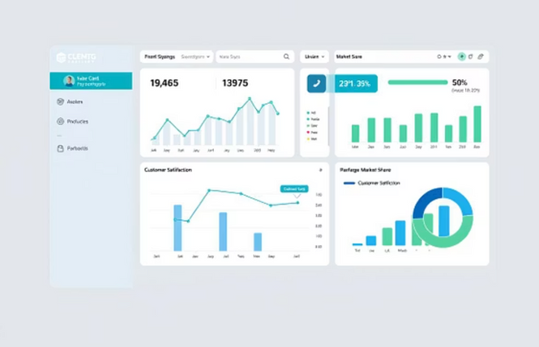
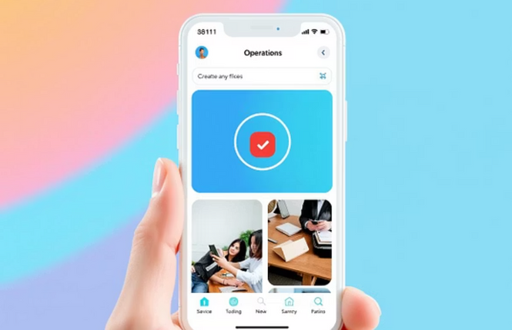
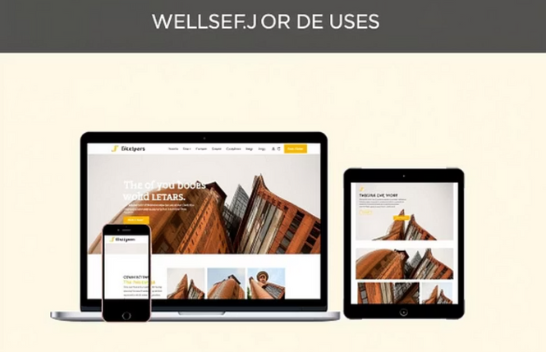
Portfolio Design & Layout: Intuitive and Engaging
Our portfolio design focuses on clarity, user-friendliness, and aesthetic appeal. Each component is meticulously crafted to ensure seamless navigation and a consistent brand experience across all platforms. We prioritize responsive layouts that adapt to any device.
Notes:
6

Slide 9

Key Features & Functionality
Automated Workflows
Real-time Analytics Dashboard
Reduce manual tasks and improve efficiency with intelligent automation for routine processes.
Visualize critical business metrics with customizable dashboards for immediate insights.
Integrated CRM
Scalable Modules
Centralize customer data for enhanced relationship management and personalized communication.
Adapt the solution to your evolving business needs with modular, expandable components.
Notes:
7

Slide 10
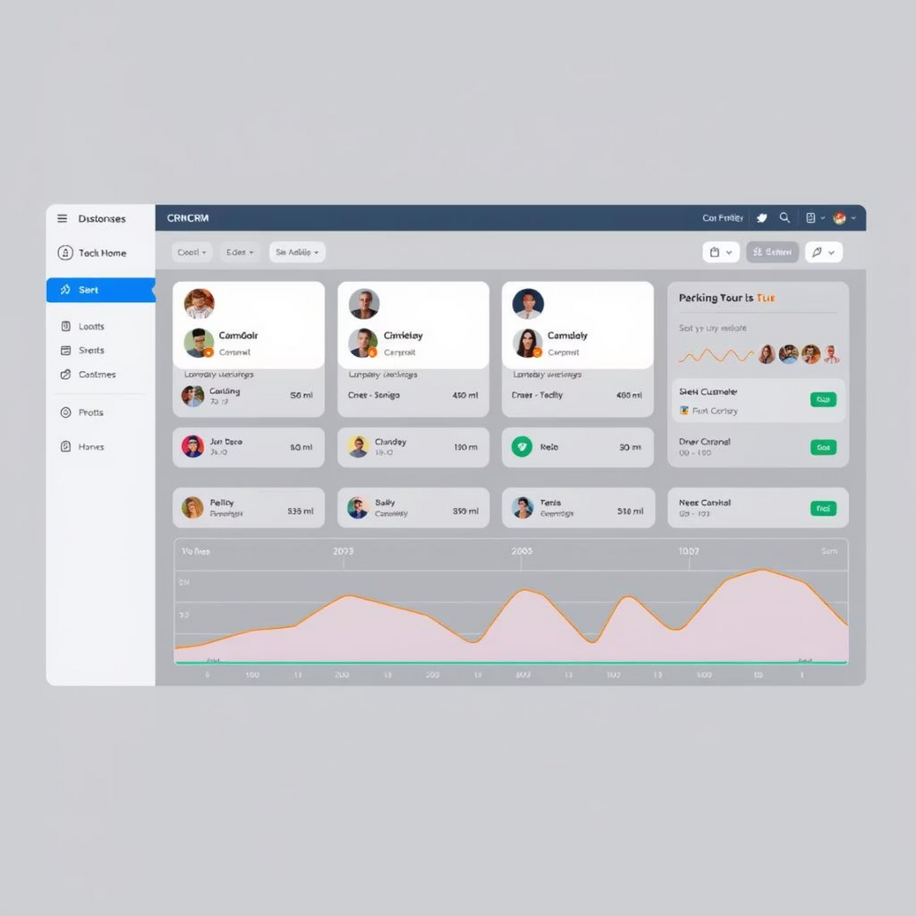

Results & Screenshots: Impact in Action
The new CRM integration has led to a 25% increase in lead conversion within the first quarter.
Real-time analytics provide insights that helped reduce operational costs by 15%.
Our solution has demonstrably improved key business metrics for early adopters, proving its value in real-world scenarios.
Notes:
8

Slide 11


Conclusion & Next Steps
Our smart tech solution is poised to revolutionize how businesses operate, fostering efficiency, growth, and adaptability in the digital age. We invite you to explore its full potential.
Notes:
9

